Slide 1

4G/5G Cell Traffic KPI Forecasting based on Dense-MLP
ITU-T AI/ML in 5G challenge
Digi Pioneer
2021-11-30

Slide 2





Background
4G/5G cell traffic KPI forecasting is a fundamental function of the network full life cycle.
More than 20% of intelligent network operation functions depend on cell traffic forecasting.
NETWORK
PLANNING
NETWORK
CONSTRUCTION
NETWORK
OPTIMIZATION
NETWORK
O & M
NETWORK
OPERATION
4G/5G Cell Traffic KPI
Forecasting Model

Slide 3





Task Analysis
Challenges in this competition also reflect challenges in real network applications.
Forecast target
Training data
Problem Statement
2×6 =12 indicators of 4G and 5G cells
Forecasting the indicators in 7-days and 1-hour frequency
Training data include hourly 4G/5G cell indicator data of 4 cities in a province in recent 6 months
Cell parameter data, including the base station name, cell name, coverage type, antenna information, bandwidth and some other information.
Large Data
Limited Hardware
Resources
Sensitive scoring rules
191GB original data for 4G cells
25GB original data for 5G cells
50GB storage, 32GB ram, Tesla v100GPU
Not very sufficient for data of 67,000 cells ×6 indicators ×2 standards
The score is a weighted average of MAPE error of each prediction
MAPE is sensitive to error when the true value is small
Challenge

Slide 4
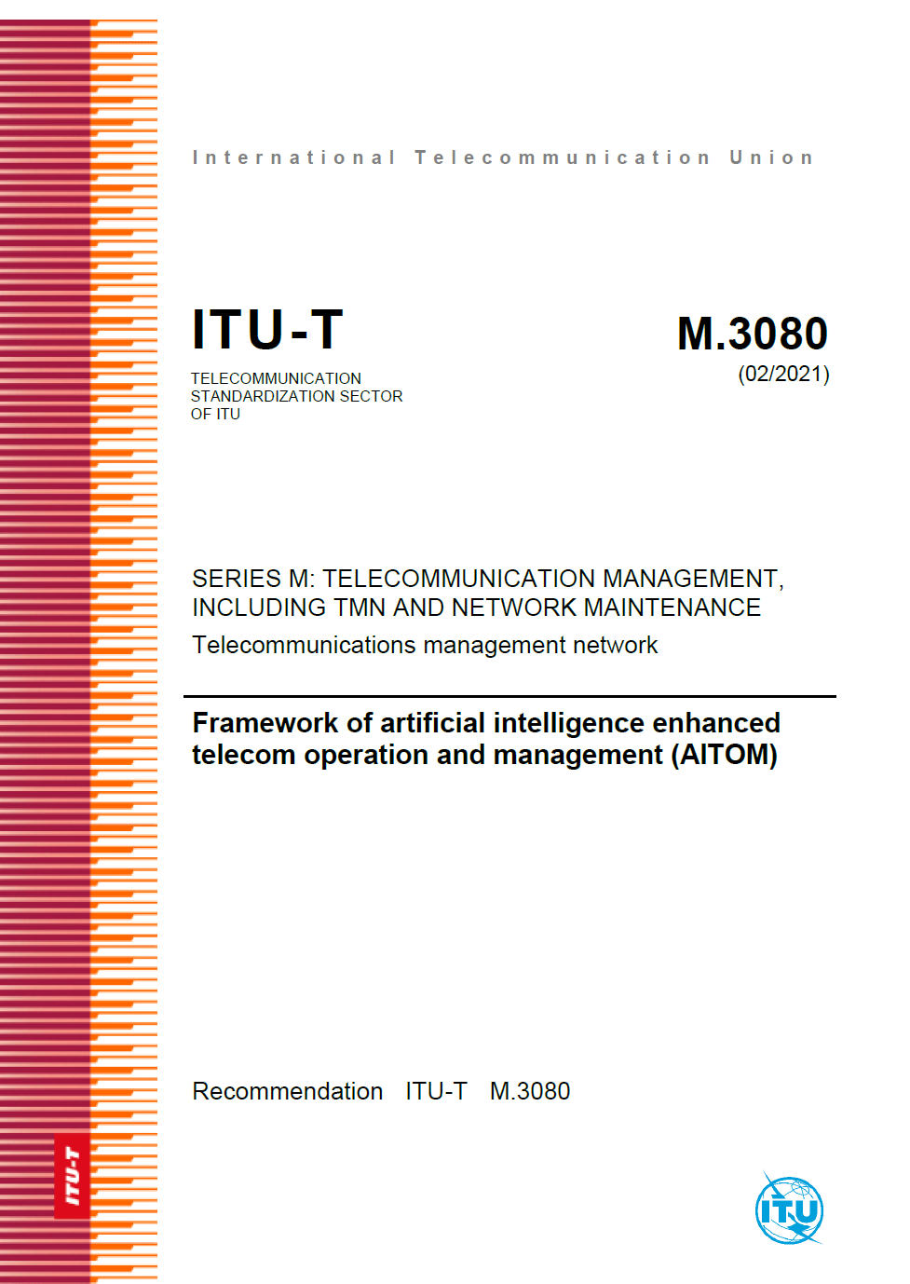

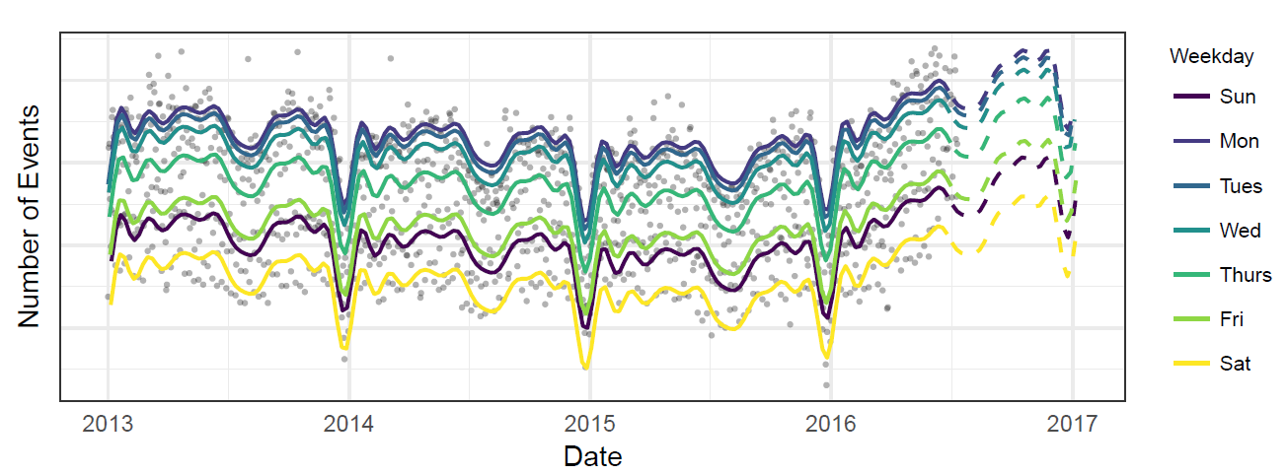
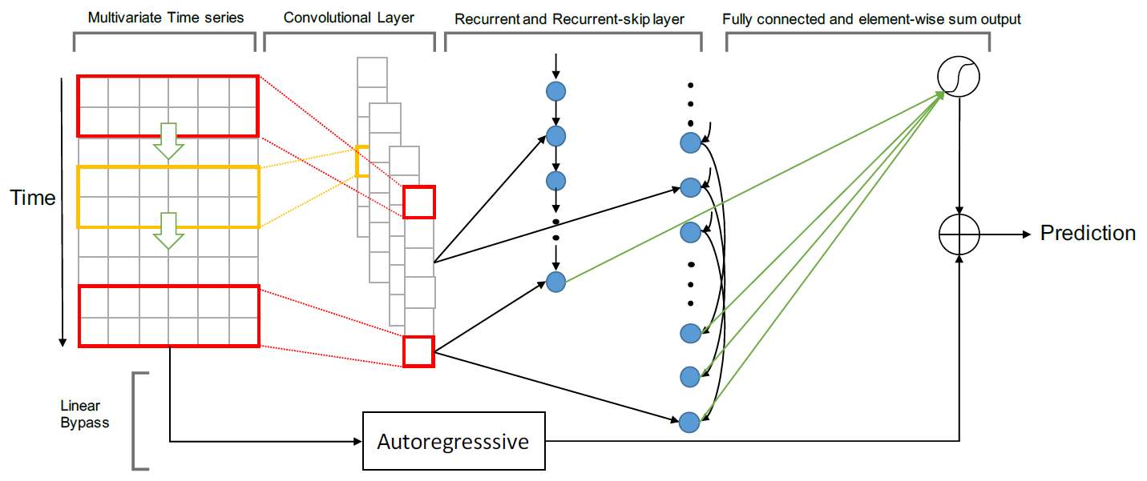

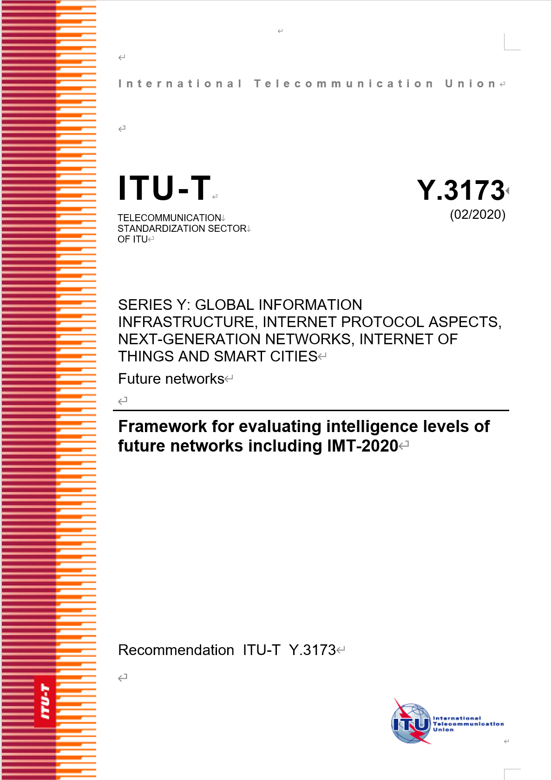
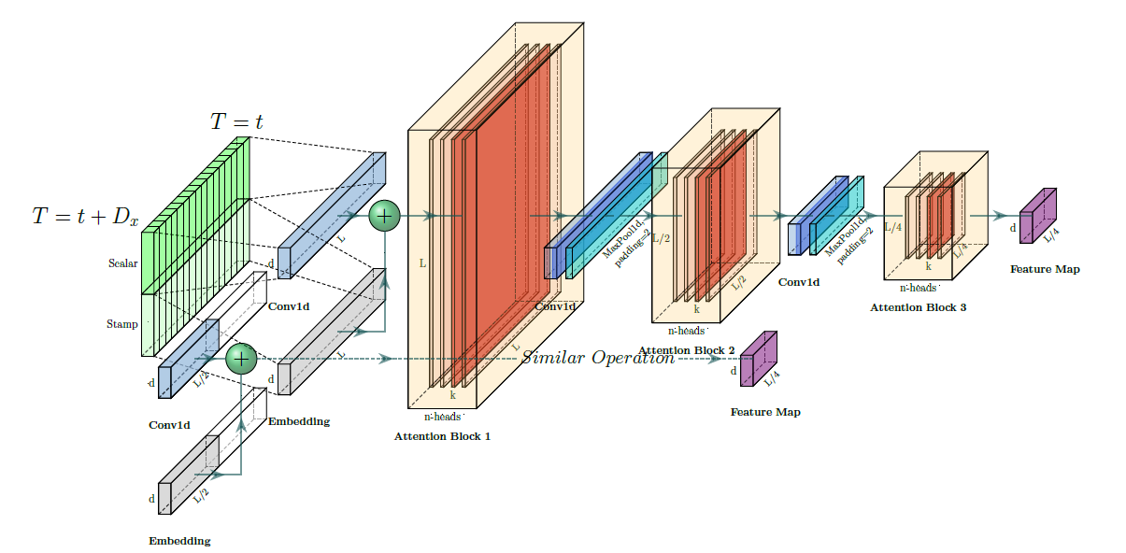
Related Works
ITU has specified some network intelligence use cases of cell traffic forecasting.
Researchers have proposed many classical time series forecasting algorithms for such cases.
Use Cases in ITU AI Standards
Time series forecasting Algorithm
Prophet
LSTNet
Informer
Taylor S J , Letham B . Forecasting at Scale[J]. The American Statistician, 2018, 72.
Lai G, Chang W C, Yang Y, et al. Modeling long-and short-term temporal patterns with deep neural networks[C]//The 41st International ACM SIGIR Conference on Research & Development in Information Retrieval. 2018: 95-104.
Zhou H , Zhang S , Peng J , et al. Informer: Beyond Efficient Transformer for Long Sequence Time-Series Forecasting[J]. 2020.
Notes:
加引用。

Slide 5
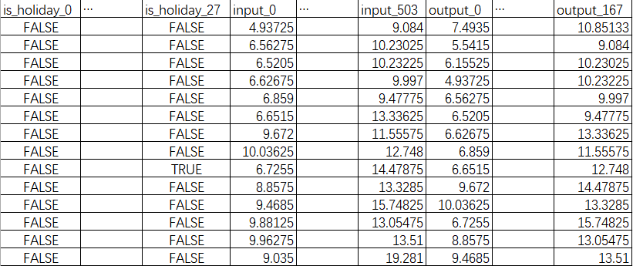
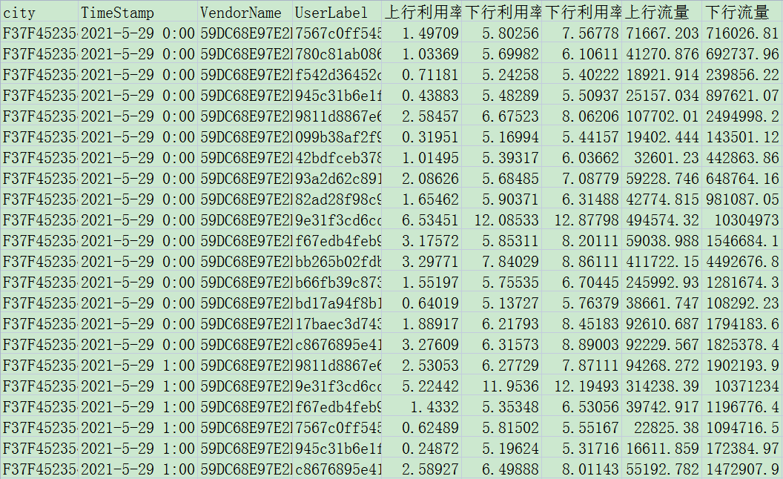
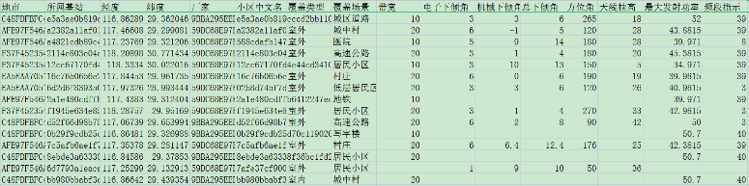
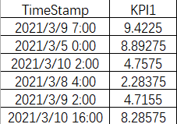
Solution Overview
Forecasting Input Data
Original Data
(200+ GB in total)
Forecasting Result
Neural Network Training Data
Neural Network Models
Time Series Data
Input
Hidden Layers
Output
×12
(2 networks × 6 KPIs)
×12

Slide 6
Research Roadmap
1.0286
LSTM, ARIMA,
etc.
0.7597
Historical data
Dense-MLP
Rule-based
Compositional
loss function
0.5516
Dynamic
learning
rate
0.28
0.2614
0.2484
2021-07-27
2021-09-30
Notes:
直线形式

Slide 7
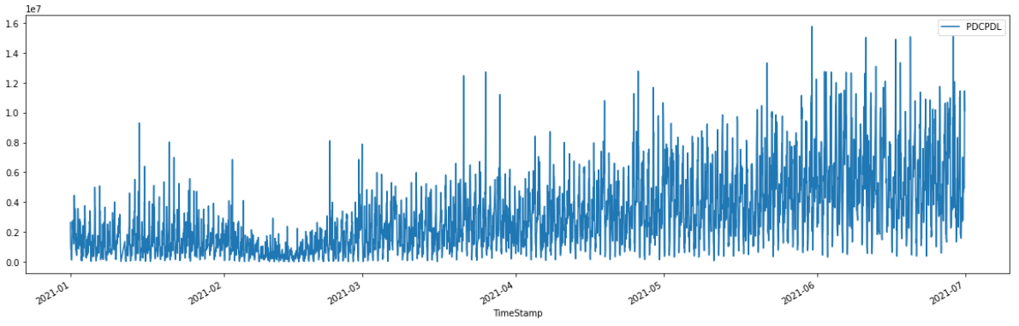
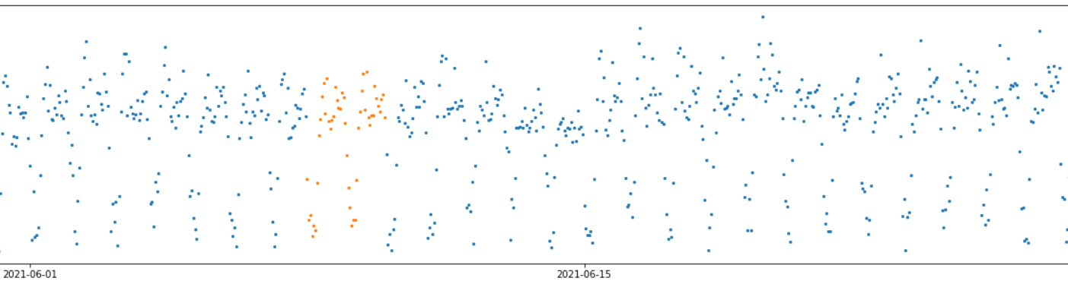
Data Insight & Preprocessing
Data insight: The values during the Spring Festival look different; data contains obvious daily and weekly periodicities.
Data preprocessing: Take only data after March 1, fill the null and zero values with weighted average of the values at the same relative time in several weeks before and after.

Slide 8
Solution: Dense-MLP Model structure
Additional fully-connected layers added
Reducing information loss of the feed forward process
Large parameter amount to fit data from 67k cells
Input: 3 weeks of historical data + holiday information of 4 weeks (3 week history + 1 week predicted)
Output: 1 week of future data
Utilizing holiday data for better prediction
FC
FC
Input
Hidden 1
Hidden 2
output
FC
FC
FC
FC

Slide 9
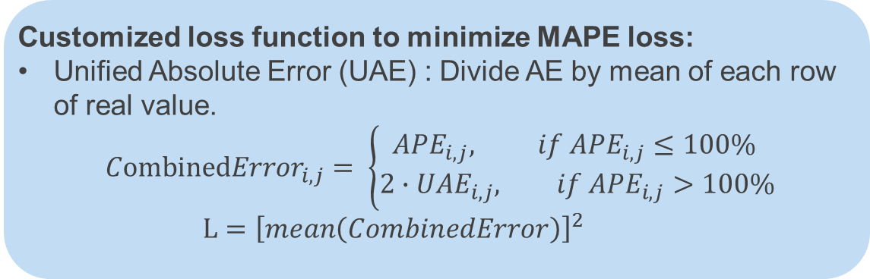
Solution: Optimizations for the Training Process
12 models trained in total:
1 model for each 4G indicator, trained on about 1.9 million rows of preprocessed data.
1 model for each 5G indicator, based on the corresponding 4G model and incrementally trained on bout 0.13 million rows of preprocessed data.
Parameters tuned to ensure fast convergence:
Linearly decreasing learning rate with different batch size tuned for different indicators
~4 hours training time on single T100 GPU
Customized loss function to minimize MAPE loss:
Unified Absolute Error (UAE) : Divide AE by mean of each row of real value.
$${CombinedError}_{i, j}= \left\{\begin{aligned}{APE}_{i, j}, if {APE}_{i, j}≤100\% \\ {2∙UAE}_{i, j}, if {APE}_{i, j}>100\%\end{aligned}\right.$$
$$L={\left[mean\left(CombinedError\right)\right]}^{2}$$

Slide 10
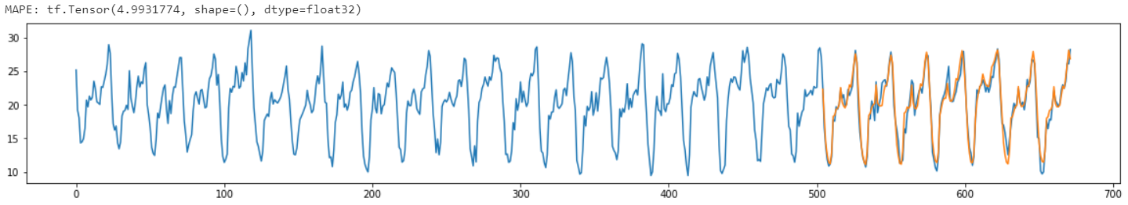
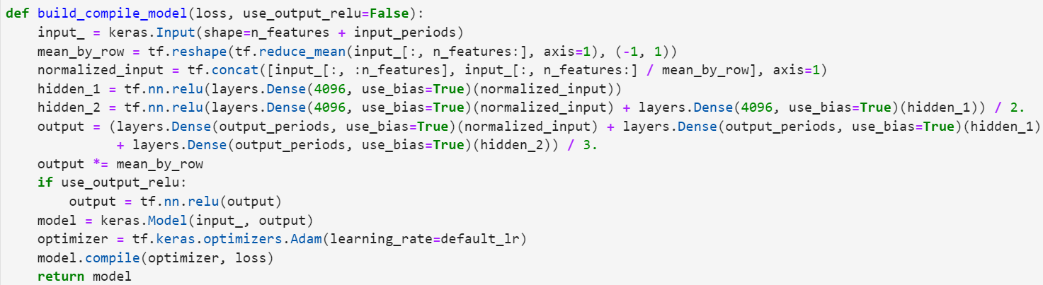
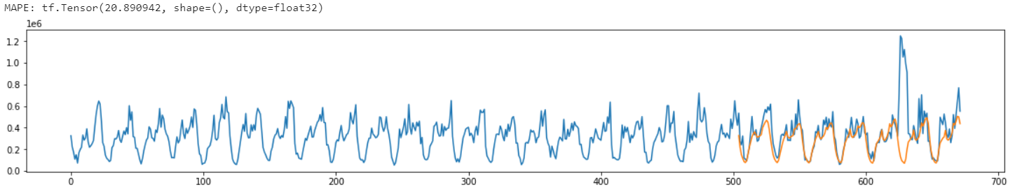
Major Advantages
Accurate Prediction
Fast Training & Inference
Flexible Deployment
Using historical 4G/5G cell traffic data of 4 cities in the past 6 months, the weighted MAPE on the following 7 days is 0.2484, significantly better than the other solutions.
4 hours training time for processed KPI data of 67000 cells
10 minutes inference time for top 20% cells
Adaptable to any scenario with different network scale and computing ability with various AI platforms.
Properly fitting the training data and not overfitting.
Notes:
和上一页作某种合并。

Slide 11
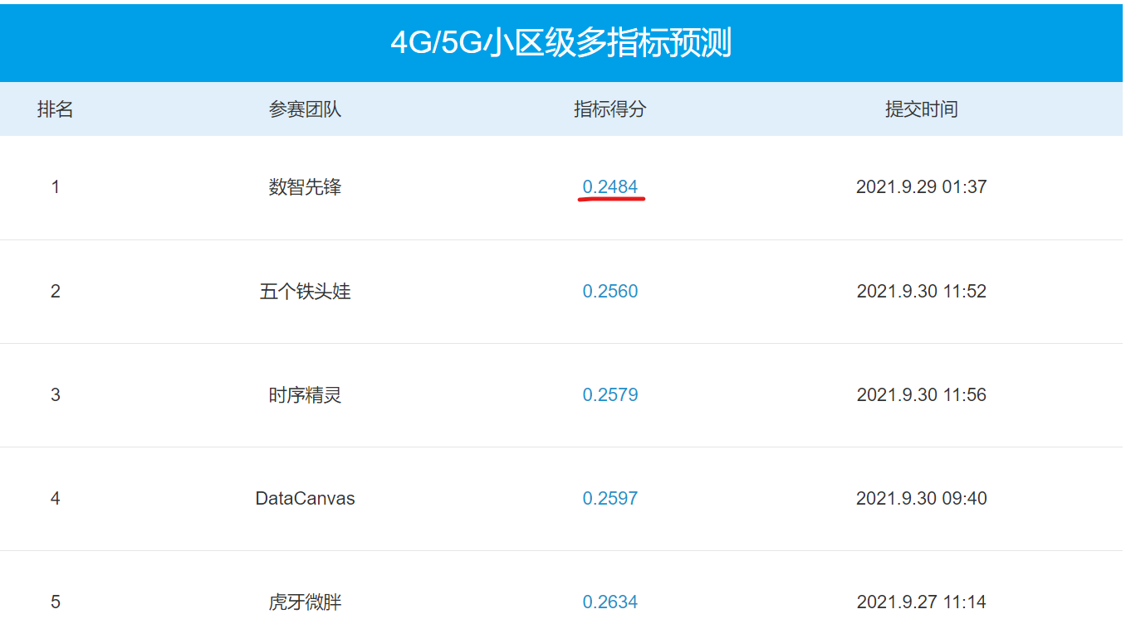

Achievement(1): the competition
Final score：0.2484, 1st prize
1st prize
Notes:
直线形式

Slide 12
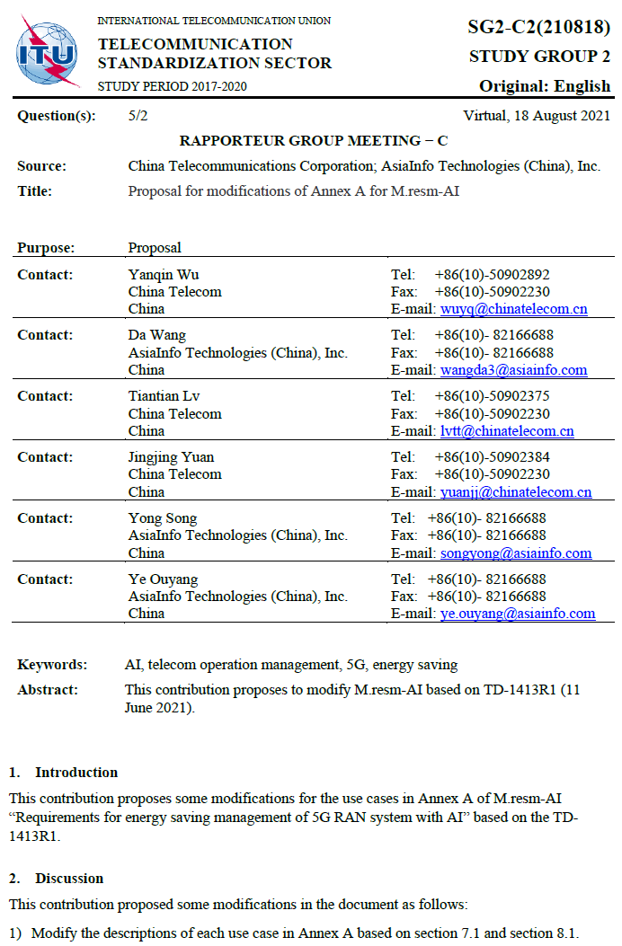
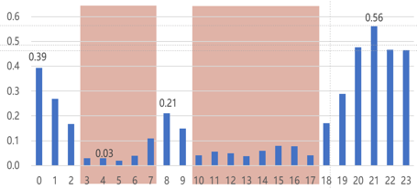
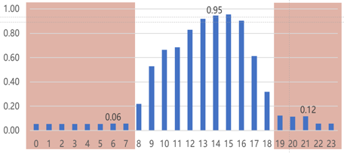
Achievement(2): Application
The model has been integrated into our network energy-saving system and proposed to ITU.
Network energy efficiency modeling
Network energy efficiency modeling
Cell Value
PrbAssnRate
Cell Perfomance
WirelessSuccConnRate
UE Service Types
Number of VIP UE
Cell Basic Information
electricity fees
Rental cost
AvgDataRate
MOS
coverage scenario
The model has been integrated into the AsiaInfo Retina system for 5G energy-saving scenario in the ChinaUnicom 5G network of JiangSu Province, improving energy-saving benefits and avoiding adverse effects on the network.
Sunset Model
Network energy efficiency evaluation system
Energy efficiency model of network equipment
…
4G/5G Cell Traffic KPI
Prediction Model
5G Energy-saving Operation
Energy-saving Scheme Generation
EPC
LTE
NR

Slide 13
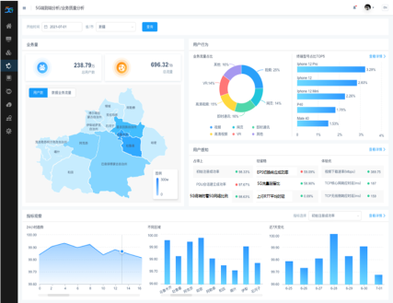
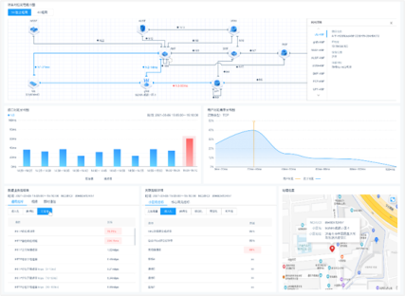
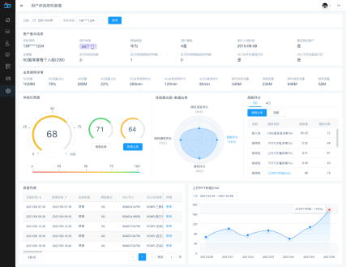
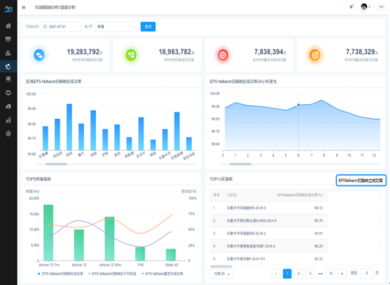
Achievement(3): More Applications
The 4G/5G cell traffic KPI forecast model will be widely applied on intelligent 5g network operation and maintenance products.
Network Qualify Evaluation
Cell Coverage Optimization
4G/5G Cell Traffic KPI Forecast Model
Customer Experience Management
Radio Resource Management

Slide 14
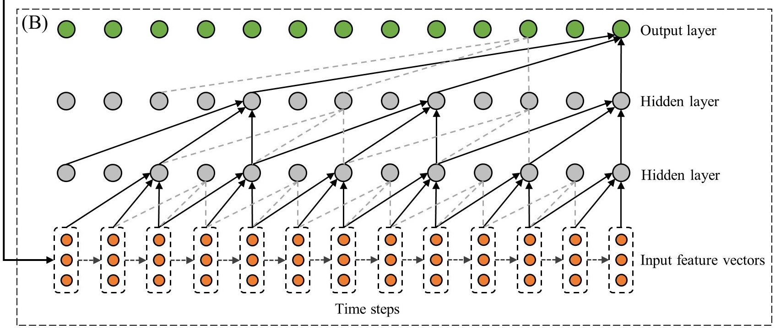
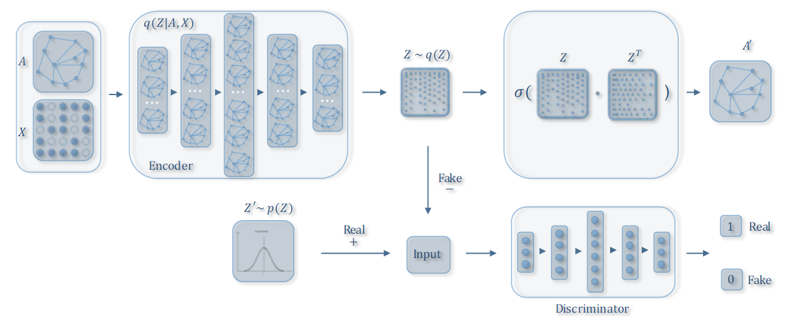
Outlook
Optimize the network architecture on real data with commonly-used network components such as convolutions, recursive layers, dilated convolutions or Transformer-like structures.
Perform Space-Time forecasting based on spatial information of cells.
Zhang L , Na J , Zhu J , et al. Spatiotemporal causal convolutional network for forecasting hourly PM2.5 concentrations in Beijing, China[J]. Computers & Geosciences, 2021, 155(11):104869.
Wu Z , Pan S , Chen F , et al. A Comprehensive Survey on Graph Neural Networks[J]. IEEE Transactions on Neural Networks and Learning Systems, 2019.

Slide 15

Thank you

